Slide 1
Initial Proposals for EOSC Federating Core & Update
Dale Robertson (Jisc), EOSC-hub T2.3 Governance and Sustainability Task Leader
Dissemination level: Public

Slide 2
Federating Core Definition
EC EOSC Implementation Roadmap SWD(2018)83 final (p 9-10)
“…the EOSC would essentially comprise a federating core and a variety of federated research data infrastructures committed to providing services as part of the EOSC”
EC EOSC Strategic Implementation Roadmap 2018-2020 (p39)
“Organise and operationalise the components of the EOSC federating core (e.g. EOSC shared resources, EOSC platform, compliance framework), to facilitate, monitor and regulate as appropriate day-to-day transactions across the federation”

Slide 3
Proposals on the Federating Core of EOSC
A key element of the EOSC architecture and organisational structure defining what EOSC provides
Has major implications for the EOSC federation model, operations, delivery channels, and ultimately, the EOSC sustainability
EOSC-hub issued a briefing document (July 2019) containing initial proposals on this topic, and continues to gather feedback

Slide 4
Proposed Federating Core and Service Portfolio
Two broad categories of resources:
Thematic services:
e.g. RI data and services, thematic e-Infra services
Common services:
e.g. Data, data management, analytics, visualisation
Service Portfolio
Thematic Services
Common Services
Federating Core
Hub Portfolio
– the federating tier
Compliance Framework
– the regulatory tier
Shared Resources
– the resource tier
Compliance framework:
Rules of Participation,
Service Management System,
Interoperability Framework,
policies
Hub portfolio:
Key Access Enabling Services, e.g. AAI, Marketplace etc.
Shared resources:
Generic services e.g. virtualisation, access, hosting

Slide 5
Federating Core
Thematic services:
e.g. RI data and services, thematic e-Infra services
Common services:
e.g. Data, data management, analytics, visualisation
Fundamental asset of the EOSC
Elements required to allow the research-targeted services to operate
Technical, human, policy and resource elements
Must be maintained over the long term
Compliance framework:
Rules of Participation,
Service Management System,
Interoperability Framework,
policies
Hub portfolio:
Key Access Enabling Services, e.g. AAI, Marketplace etc.
Shared resources:
Generic services e.g. virtualisation, access, hosting

Slide 6

Federating Core – Compliance Framework
Regulatory Tier
Thematic services:
e.g. RI data and services, thematic e-Infra services
Common services:
e.g. Data, data management, analytics, visualisation
Defines the policies and processes for the demand side and supply side to engage with EOSC
Includes the Rules of Participation, the Service Management System, Interoperability Guidelines for thematic and common services, and related policies
Compliance framework:
Rules of Participation,
Service Management System,
Interoperability Framework,
policies
Hub portfolio:
Key Access Enabling Services, e.g. AAI, Marketplace etc.
Shared resources:
Generic services e.g. virtualisation, access, hosting

Slide 7
Federating Core – Hub Portfolio
Federating Tier (aka EOSC Platform in some EC documents)
Thematic services:
e.g. RI data and services, thematic e-Infra services
Common services:
e.g. Data, data management, analytics, visualisation
Activities and tools (technical and human) required to provide coordinated access to and management of resources provided by multiple suppliers (internal and external to the EOSC)
Compliance framework:
Rules of Participation,
Service Management System,
Interoperability Framework,
policies
Hub portfolio:
Key Access Enabling Services, e.g. AAI, Marketplace etc.
Shared resources:
Generic services e.g. virtualisation, access, hosting

Slide 8
Federating Core – Hub Portfolio (cont)
Examples of Hub Service Portfolio components (to be further expanded)
EOSC Portal
Helpdesk
Support Services
AAI
Monitoring
Accounting
CMDB
Collaboration software
Operations portal
Thematic services:
e.g. RI data and services, thematic e-Infra services
Common services:
e.g. Data, data management, analytics, visualisation
Compliance framework:
Rules of Participation,
Service Management System,
Interoperability Framework,
policies
Hub portfolio:
Key Access Enabling Services, e.g. AAI, Marketplace etc.
Shared resources:
Generic services e.g. virtualisation, access, hosting

Slide 9
Federating Core – Shared Resources
Resource Tier
Thematic services:
e.g. RI data and services, thematic e-Infra services
Common services:
e.g. Data, data management, analytics, visualisation
Includes the scientific outputs (data, applications, software, pipelines etc) and the storage and compute hosting platforms needed to deposit, share and process these outputs
Precise makeup remains to be defined
Compliance framework:
Rules of Participation,
Service Management System,
Interoperability Framework,
policies
Hub portfolio:
Key Access Enabling Services, e.g. AAI, Marketplace etc.
Shared resources:
Generic services e.g. virtualisation, access, hosting

Slide 10
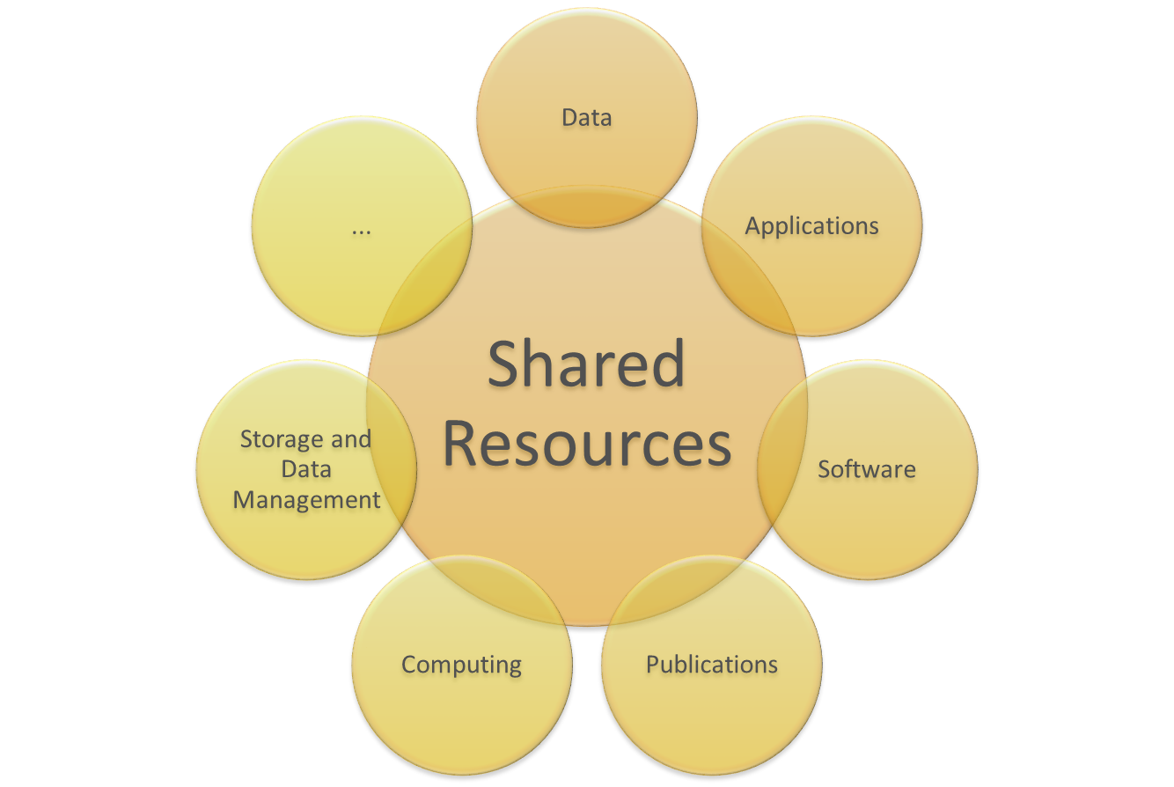
Federating Core – Shared Resources

Slide 11
Service Portfolio
EOSC Service Portfolio
Thematic services:
e.g. RI data and services, thematic e-Infra services
Common services:
e.g. Data, data management, analytics, visualisation
Added-value resources (thematic and common) making use of the EOSC Federating Core and providing complementary capabilities to EOSC users
Compute
Data management
Networking
Processing & Analysis
Security & Operations
Sharing & Discovery
Storage
Training & Support
Compliance framework:
Rules of Participation,
Service Management System,
Interoperability Framework,
policies
Hub portfolio:
Key Access Enabling Services, e.g. AAI, Marketplace etc.
Shared resources:
Generic services e.g. virtualisation, access, hosting

Slide 12
Governance and Sustainability
Federating Core
The entire Federating Core should be governed by the EOSC
Funding should sustain the costs of federating existing digital infrastructures
Funding from member states, EC, international research organisations etc
Service Portfolio
Services independently owned by their respective providers
Discoverable and accessible through the EOSC portal

Slide 13
Update From Feedback To Date
Data should continue to be owned, hosted and funded as now
Can’t adopt an open data policy and then charge users for data!
-> No data in the Shared Resources of the EOSC
Shared resources could include a local copy of data, however
EOSC should not produce or guarantee the quality of data
EOSC should allow access to data and certify the quality of characteristics of datasets such as metadata and PIDs
EOSC core functions: enable access to data, software, storage, computing and other capabilities and resources
Deliver them through EOSC in a more coordinated and cost-effective manner, avoiding duplication

Slide 14
Update From Feedback To Date (cont)
Opportunity to generalise the adoption of FAIR data policies for the benefit of a wide community of users
by widening access to data produced and stored by national/European research communities
Single universe for all data
Equality of access to data for researchers, regardless of their institution or geographical location
Economies of scale, avoid double funding, cost savings for funders
EOSC should fund the cost of open data policy
Research Infrastructures should ensure their project funding includes the cost of storage and processing of data produced by their users
Co-funding model could continue as now for national and European research communities
Allowing access to data through the EOSC would require charging on a cost recovery basis
Cost recovery mechanism to be determined

Slide 15
EOSC Value-Add
For Service Providers
the EOSC will offer greater visibility of their services and the outputs they produce
presented in EOSC catalogues/marketplaces
“quality assessed” by the EOSC Rules of Participation
supporting their efforts to make their outputs FAIR
For Researchers
the EOSC will provide visibility of and access to data and other research resources (software, tools), many of which may at present be out of reach to them
presented in catalogues
“quality assessed” against the EOSC Rules of Participation
plus access to Shared Resources for common user needs such as storage and compute

Slide 16
EOSC Value-Add (cont)
For Funders
the EOSC would deliver cost savings through economies of scale, and would avoid double funding
It may be the quality assurance aspect, plus the ability to access and re-use data alongside Shared Resources through the same portal, which represents the unique value-add of the EOSC and provides the incentive to supply to and use the EOSC

Slide 17
Further Steps and Call for participation
Evolution of concepts and proposals, in collaboration with other EOSC implementation projects
Updating proposals to reflect feedback to date
incorporating procurement/business model considerations
Aim is to produce a community position paper on the Federating Core capabilities, policies and activities, with participation from EOSC projects and stakeholders
-> Input to the Sustainability and Architecture EOSC working groups
Contributions welcome!

